Slide 1
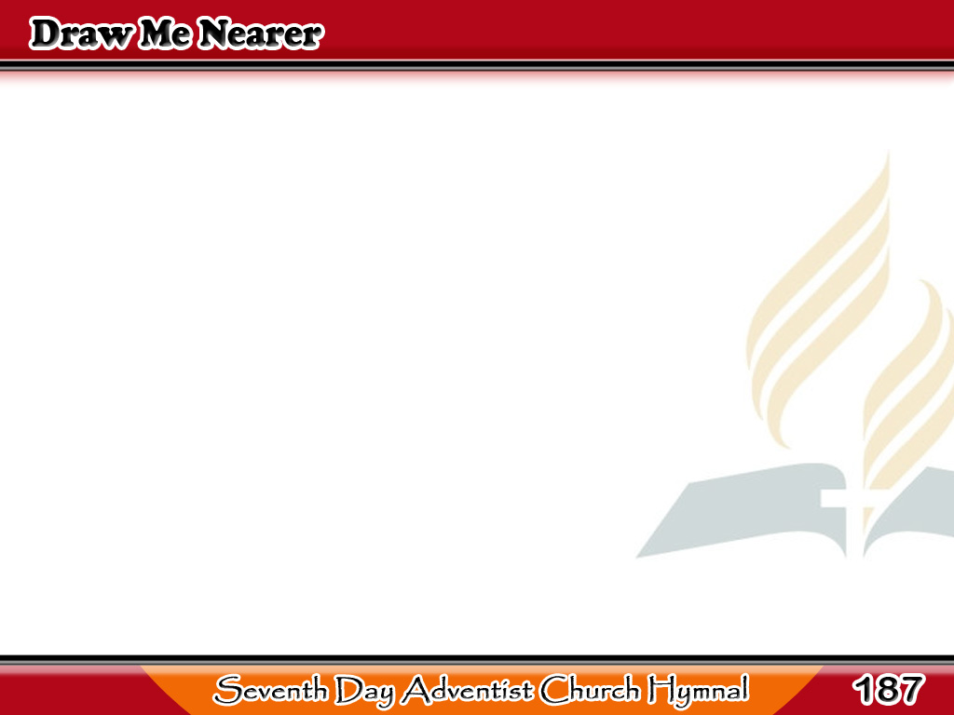

Ako’y sa Iyo, Pangino’ng Mahal
I am Thine, O Lord,
I have heard Thy voice,
And it told Thy love to me;
1/3

Slide 2
Ako’y sa Iyo, Pangino’ng Mahal
But I long to rise
in the arms of faith,
And be closer drawn to Thee.
1/3

Slide 3
Ako’y sa Iyo, Pangino’ng Mahal
-Refrain-
Draw me nearer,
nearer, blessed Lord,
To the cross where
Thou hast died;
1/3

Slide 4
Ako’y sa Iyo, Pangino’ng Mahal
-Refrain-
Draw me nearer,
nearer, blessed Lord,
To Thy precious,
bleeding side.
1/3

Slide 5
Ako’y sa Iyo, Pangino’ng Mahal
Consecrate me now
to Thy service, Lord,
By the power of grace divine;
2/3

Slide 6
Ako’y sa Iyo, Pangino’ng Mahal
May my soul look up
with a steadfast hope
And my will be lost in Thine.
2/3

Slide 7
Ako’y sa Iyo, Pangino’ng Mahal
-Refrain-
Draw me nearer,
nearer, blessed Lord,
To the cross where
Thou hast died;
2/3

Slide 8
Ako’y sa Iyo, Pangino’ng Mahal
-Refrain-
Draw me nearer,
nearer, blessed Lord,
To Thy precious,
bleeding side.
2/3

Slide 9
Ako’y sa Iyo, Pangino’ng Mahal
O the pure delight
of a single hour
That before Thy throne
I spend,
3/3

Slide 10
Ako’y sa Iyo, Pangino’ng Mahal
When I kneel in prayer,
and with Thee, my God,
I commune as friend
with friend!
3/3

Slide 11
Ako’y sa Iyo, Pangino’ng Mahal
-Refrain-
Draw me nearer,
nearer, blessed Lord,
To the cross where
Thou hast died;
3/3

Slide 12
Ako’y sa Iyo, Pangino’ng Mahal
-Refrain-
Draw me nearer,
nearer, blessed Lord,
To Thy precious,
bleeding side.
3/3

